Slide 1
The Urban Displacement Project: Indicators to Predict Neighborhood Change
Karen Chapple
Professor of City & Regional Planning
University of California, Berkeley

Slide 2
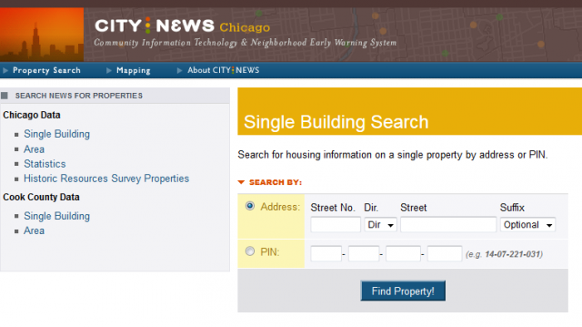
Understanding neighborhood change: The first early-warning systems

Slide 3
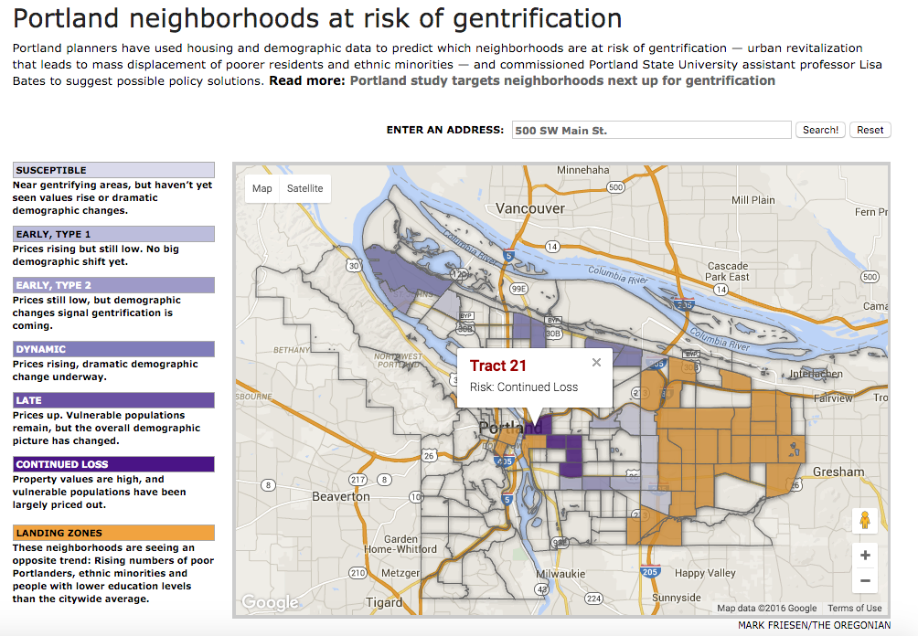
Fast forward to the 2000s – Gentrification!
Portland (Portland State)
http://projects.oregonlive.com/maps/gentrification/

Slide 4
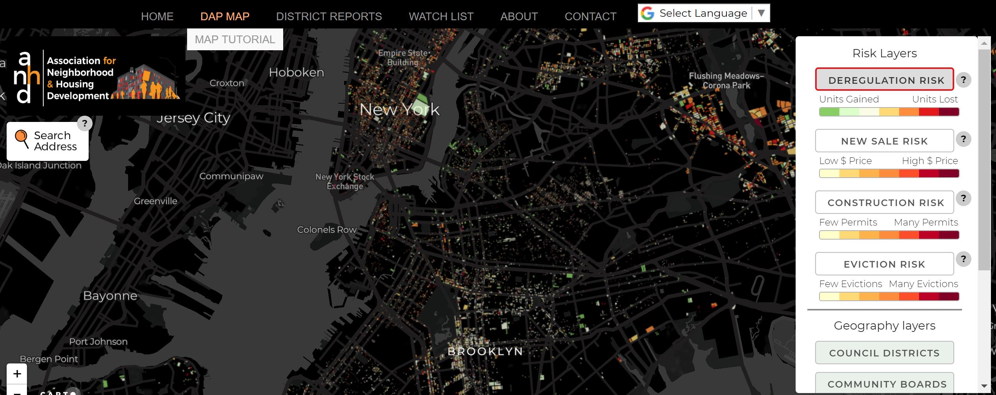
Displacement Action Project Map

Slide 5
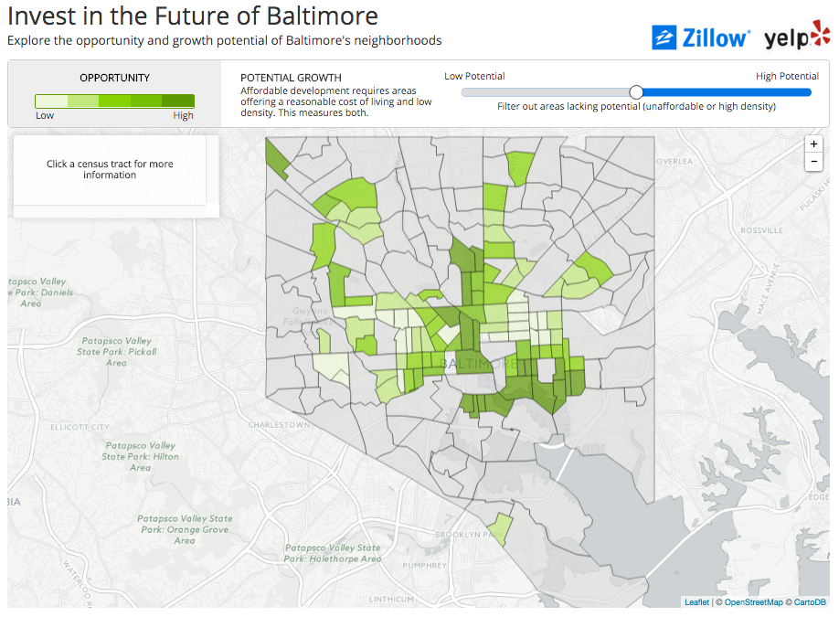
Real estate development potential!
Invest in the Future of Baltimore
http://files.zillowstatic.com/research/public/Whitehouse_Hackathon/index.html

Slide 6
A Question…
Carol Lee
Chapple and Zuk, 2016. “Forewarned: The Use of Neighborhood Warning Systems for Gentrification and Displacement.”
There seems to be a fine line between gentrification and revitalization. If communities seek a “sweet spot” where they have just enough economic development to have resources, does that not also contribute to cyclical inequality? Are housing units built with Low-Income Housing Tax Credits guaranteed to go to residents from the neighborhood where the units are built?

Slide 7
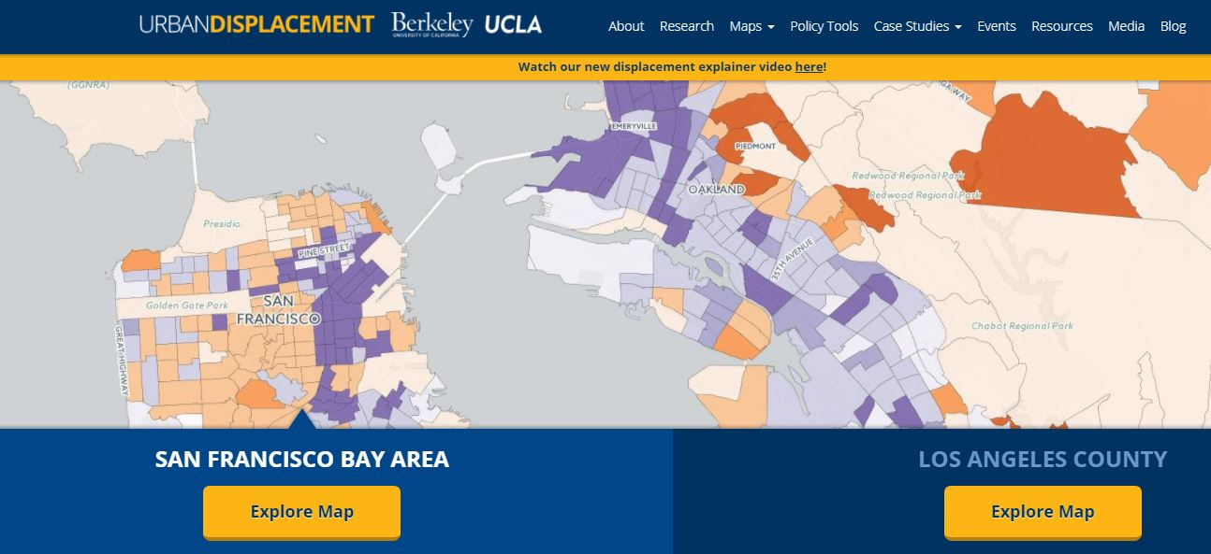
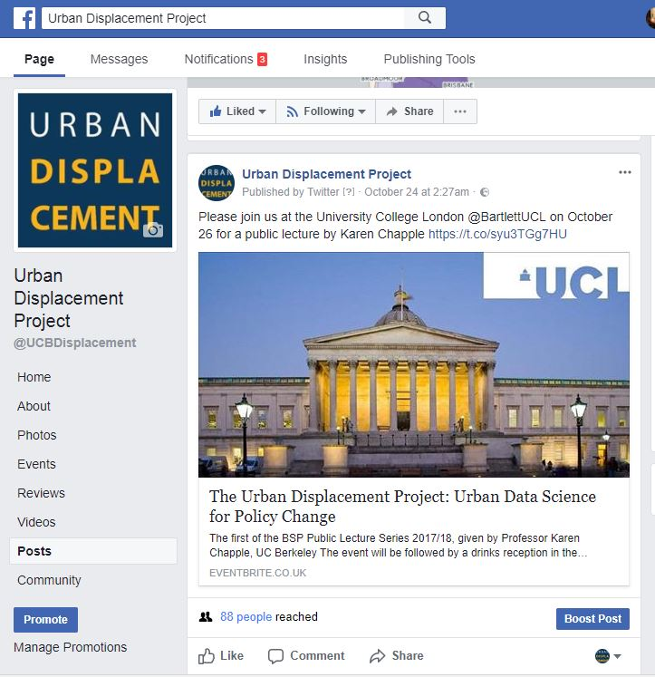
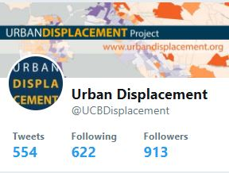
http://www.urbandisplacement.org
Gentrification and displacement:
Residential
Commercial
Industrial

Slide 8
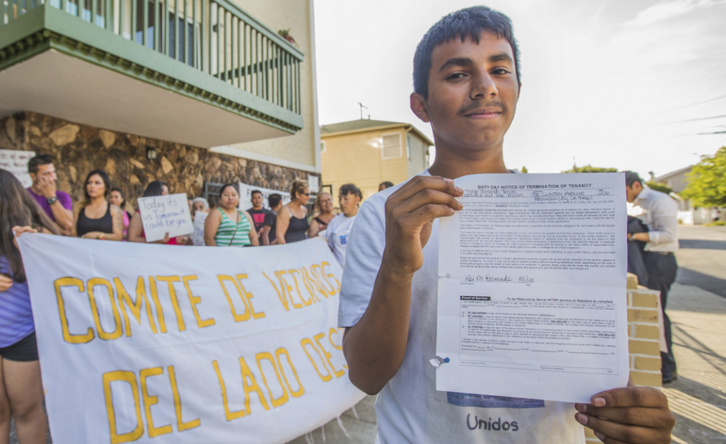
Regional sustainability planning, urban displacement?
2040 Plan Bay Area:
2 million new residents, 1 million new jobs
80% of new growth in 5% of land area
+
=

Slide 9
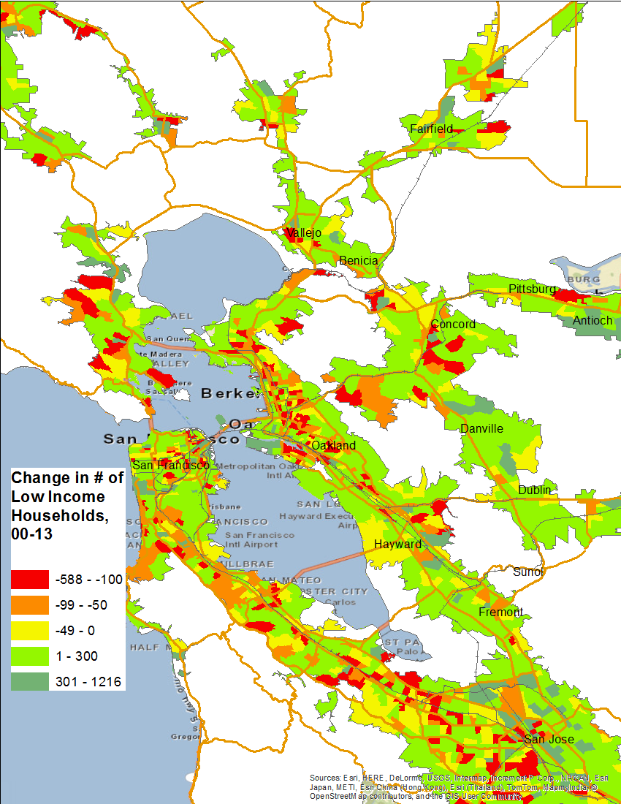
Displacement Indicator #1: Change in Low Income Households
On average tracts gained 60 low income households.
Loss proxies for displacement
Use ACS household income data to construct this indicator. For low-income definition, use 80% of county median household income. Or, use households in poverty (or 200% of the poverty line).

Slide 10
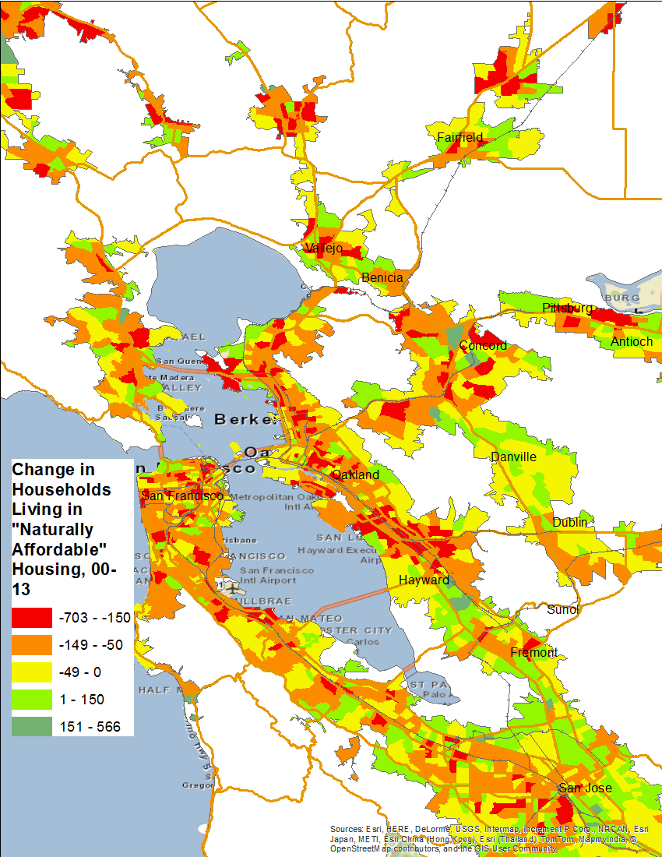
Displacement Indicator #2: Loss of Naturally Occurring Affordable Housing
Loss of housing affordable at 30% of income or less
-- use rent burden by income data from ACS for this, and calculate change in low-income rent-burdened households over time.

Slide 11
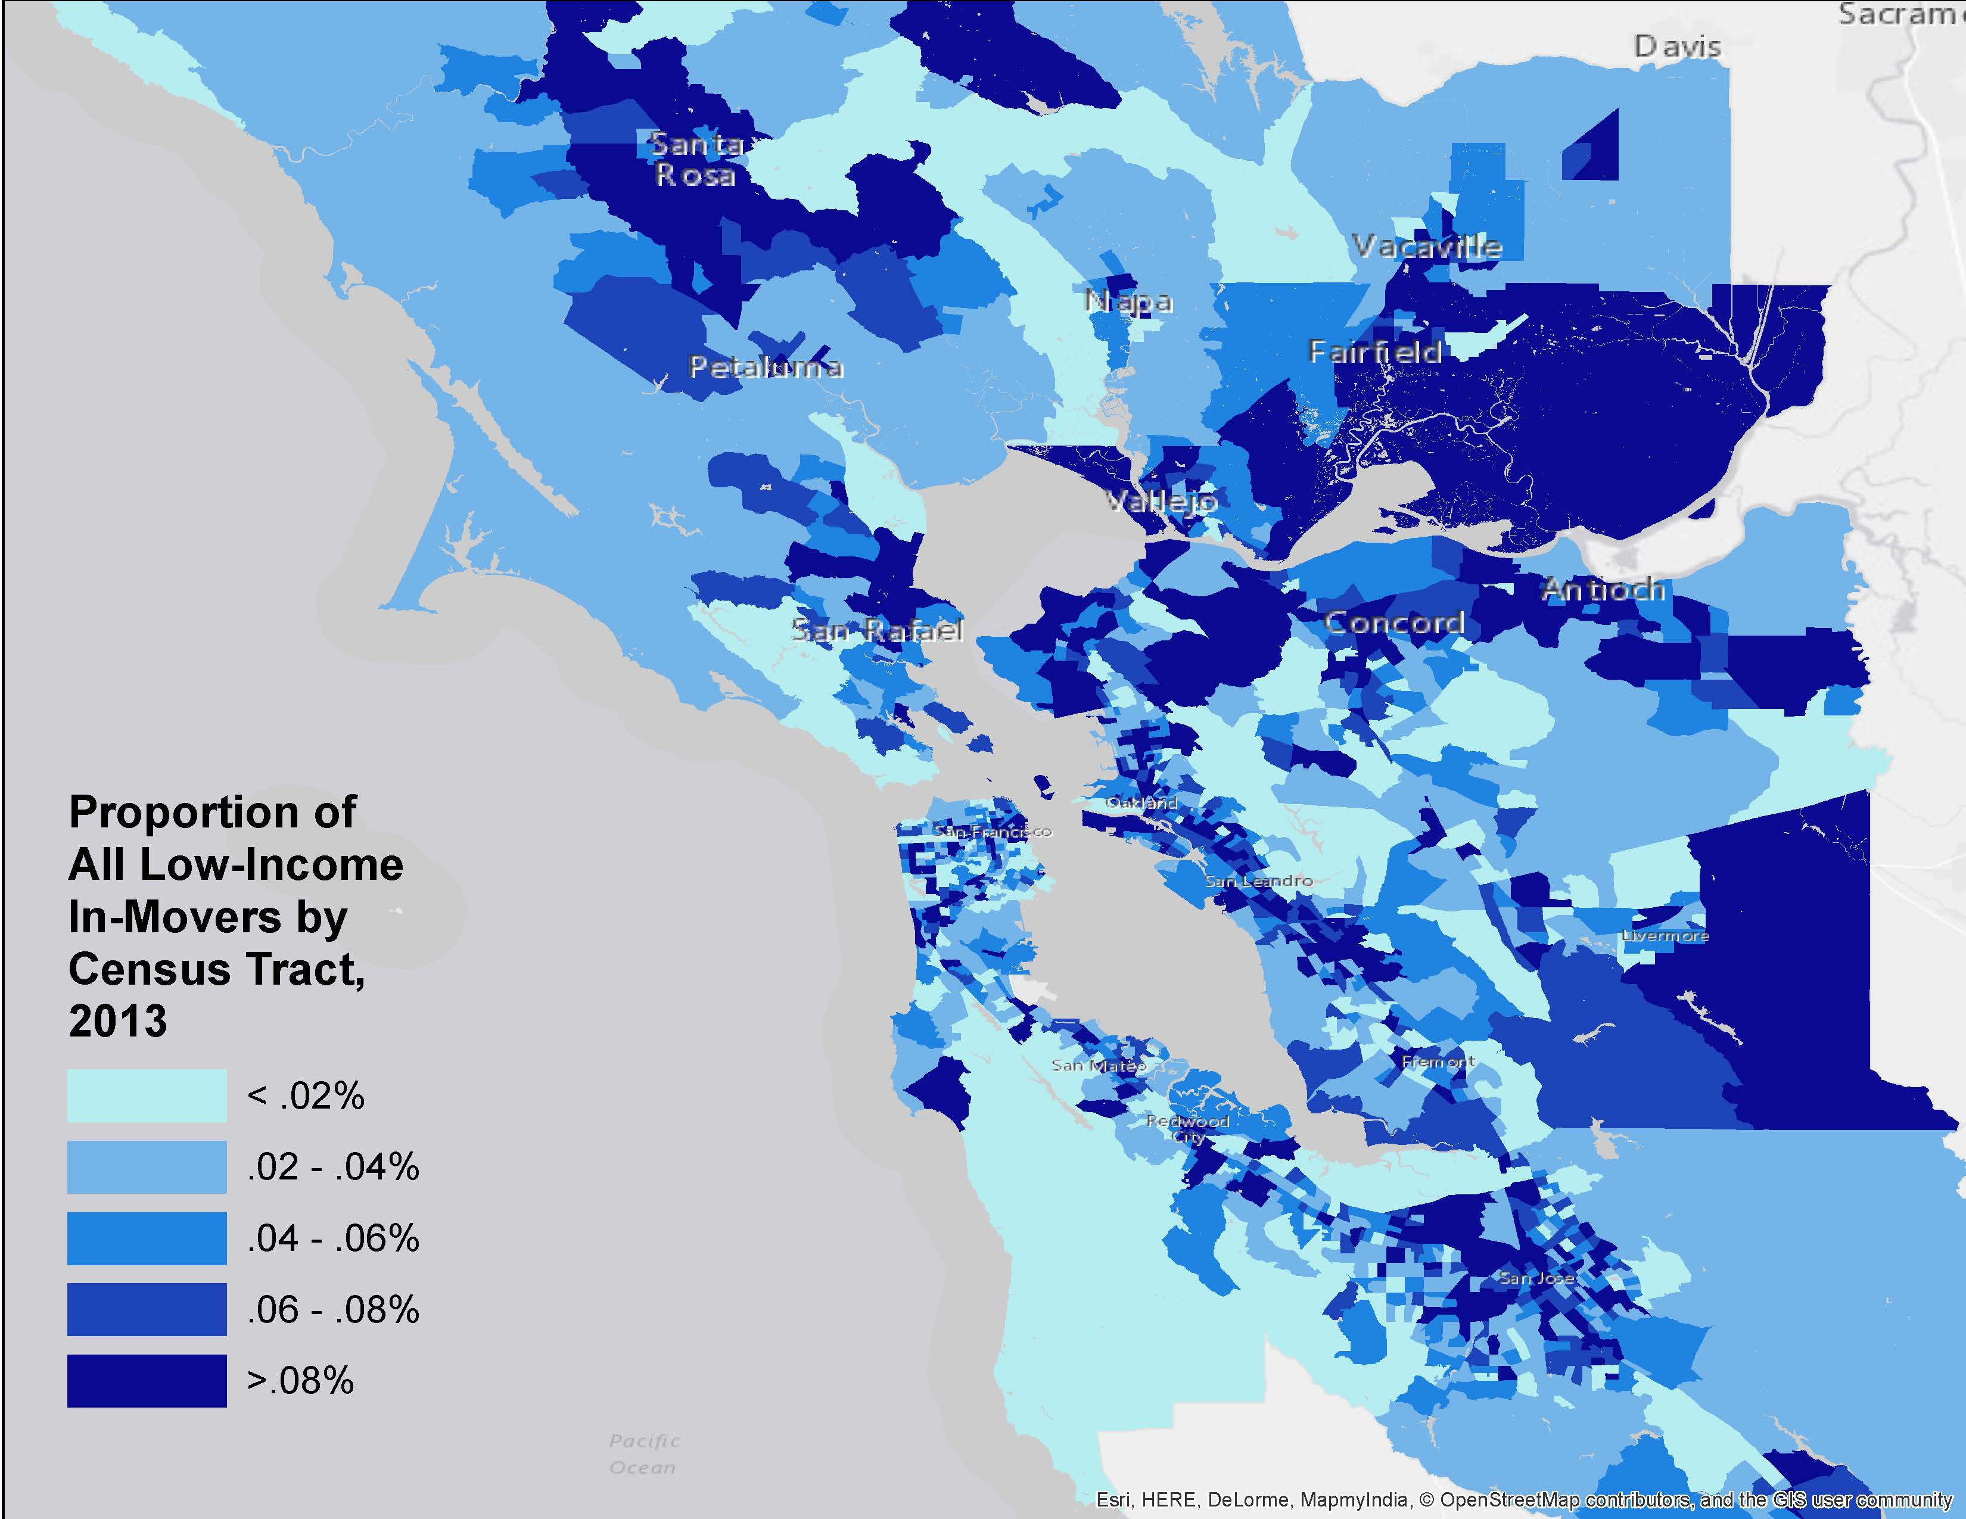
Displacement Indicator #3: Exclusionary displacement of low-income households (Look for ACS data on Year householder moved in by income or race/ethnicity)

Slide 12
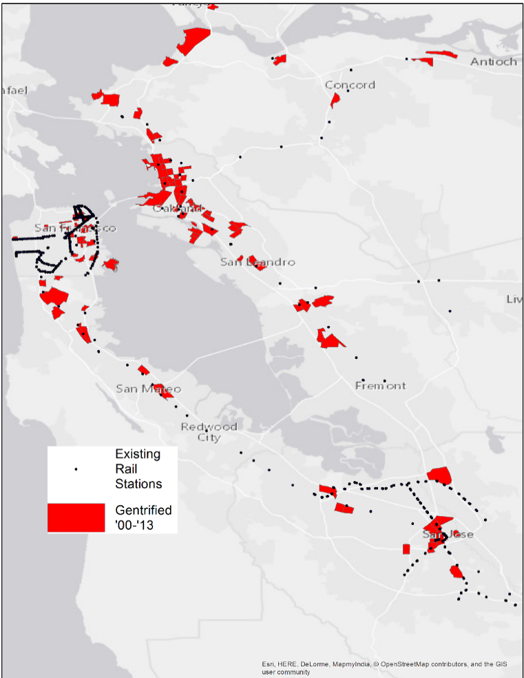
Gentrification Indicator Gentrification definition: For vulnerable neighborhoods: Change in household median income > regional median + Change in % of college-educated > regional median + Change in housing prices or rent > regional median

Slide 13
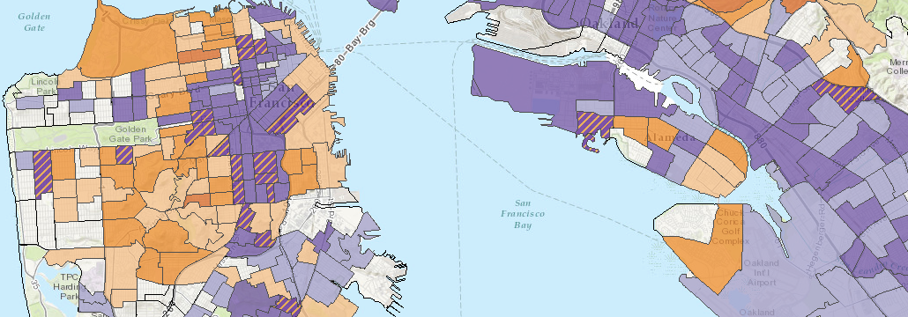
Purple = Low-income
Regressions to determine whether tracts are at risk
Orange = Moderate/High-income
Exclusive areas losing low-income households
Gentrification typology
maps (1990 – 2015)
urbandisplacement.org
Notes:
In 2009, the Association of Bay Area Governments sponsored Berkeley Professor Karen Chapple and the UDP to conduct an analysis of neighborhood change in the San Francisco Bay Area from 1990 to 2000.
This study defined gentrifying neighborhoods as low-income census tracts in central city locations in 1990 that, by 2000, had experienced housing appreciation and increased educational attainment that were higher than the nine-county regional average. We then used statistical modeling to create a susceptibility index based on 19 socioeconomic, locational, and built environment factors.
A multivariate statistical model that had gentrification as the dependent variable and a set of 19 factors for 1990 as independent variables. When census tracts scored above the regional average for each variable, they received a value of 1; the susceptibility index summed the scores across the variables.
Expanding on this study, the URD wanted to examine different stages and types of neighborhood change – such as the different stages of gentrification and exclusion.
With funding from the California Air Resources Board, we were able to look at better quantifying displacement and the role of transit investment as well as the MTC Sustainable communities Initiative Grant process. This work was done in collaboration with Plan Bay Area.
This study allowed us to combine top-down data analysis with bottom-up qualitative case studies, which we completed in collaboration with community-based organizations in the Bay Area and Los Angeles. (MAP)
Throughout this process, we use an iterative process of analyzing data, reviewing the literature, and then presenting interim typologies of neighborhood change to stakeholders, and then revising and refining. The final typology was vetted via several workshops with a project advisory committee and also via community forums.
Our gentrification typology maps analyze regional data on housing, income and other demographics to better understand and predict where gentrification and displacement is happening and will likely occur in the future. Purple tracts are low-income, and orange tracts are moderate or high-income. The lighter purple indicates at risk of gentrification or displacement, and the darker purple is ongoing gentrification or displacement. The lighter orange is for moderate/high-income neighborhoods that are at risk of exclusion of low-income neighborhoods, and the darker oranges are neighborhoods with ongoing or advanced exclusion. Striped purple are neighborhoods that were low-income in 1990, but have undergone such dramatic demographic change that they would now be characterized as moderate or high-income. Please see our website, urbandisplacement.org, to learn more about our methodology, and further explore the maps.
A snapshot:
61% of low-income tracts are at risk of gentrification and/or displacement, or already experiencing gentrification and/or displacement.
63% of moderate or high-income tracts are at risk of displacement, or have ongoing or advanced gentrification / exclusion of low-income neighborhoods.

Slide 14
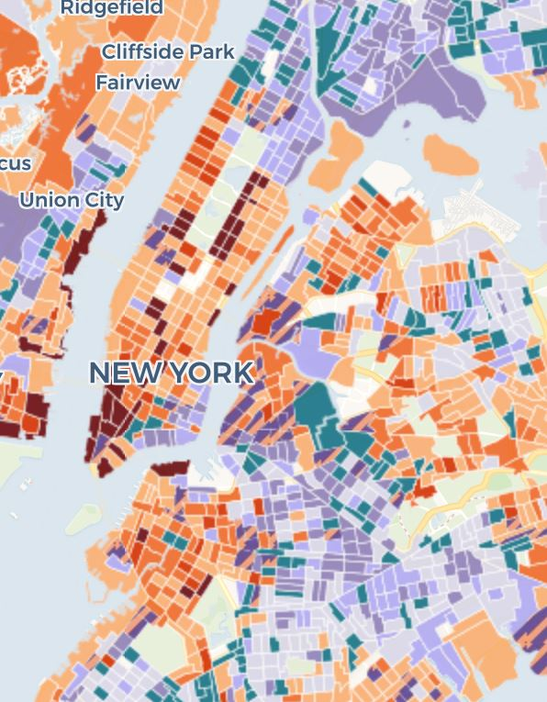
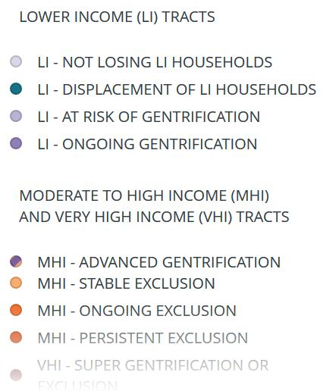
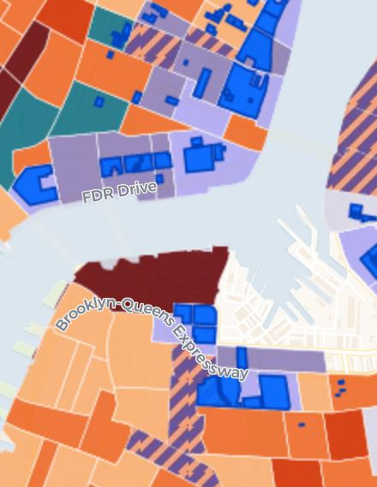

Slide 15
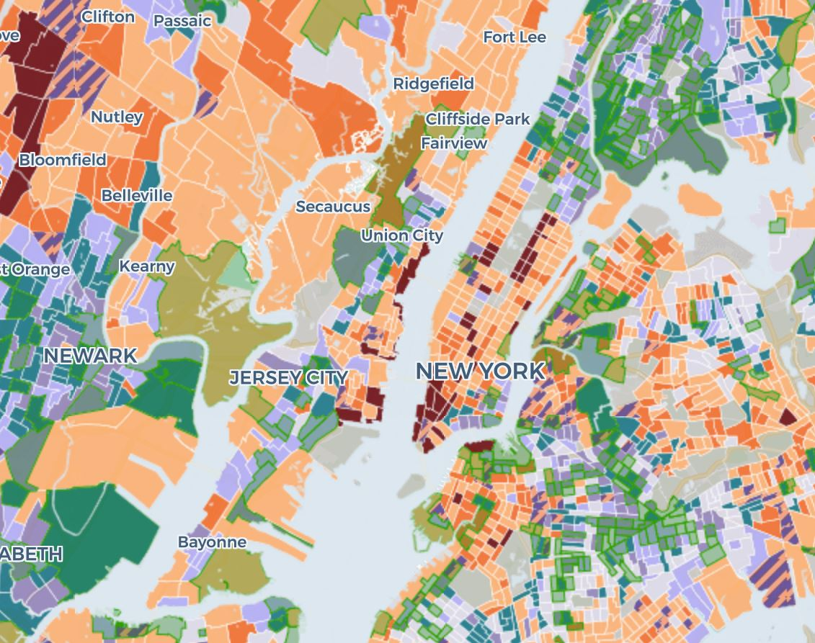
NY with Opportunity Zones

